Slide 1
CS60064 Spring 2022 Computational Geometry
Instructors
Bhargab B. Bhattacharya (BBB)
Partha Bhowmick (PB)
Lecture 07
19 January 2022
Indian Institute of Technology Kharagpur
Computer Science and Engineering
Notes:
Good Morning!
The title of today’s talk is “On some Planar Partitioning Problems”.

Slide 2
Orthogonal Polygonization
All edges are axis-parallel
In other words, internal turn angles are either π/2 or 3π/2
orthogonal polygonization
(from unlabelled vertices to polygon)

Slide 3
Applications of Orthogonal Polygonization:
Remote Sensing and GIS
Aerial Image

Slide 4
Image to Corner Data
Data Compression

Slide 5
Reconstruction via Orthogonal Polygonization

Slide 6
Aerial Image

Slide 7
Image to Corner Data

Slide 8
Reconstruction via Orthogonal Polygonization

Slide 9
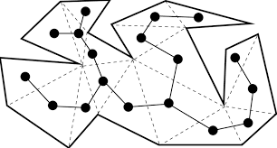
Problem of the Day Euclidean Shortest Path (ESP) in a Polygon
t
s
The dual of a triangulated polygon is a tree
ESP between s and t
ESP comprises a sequence of straight edges, joining only at the vertices of the polygon;
The triangles intercepted by the ESP appear as vertices on the path of the dual (tree) that connects the two triangles corresponding to s and t

Slide 10
Recap: Triangulation via Ear-Clipping Algorithm
Every polygon has at least two ears!
Find an ear, fix a diagonal, chop the ear and iterate

Slide 11
Triangulating a polygon: Improvements
Simple O(n²) time algorithm based on Meister’s two-ear theorem
Long-standing open problem: can it be done in O(n) time?
[Chazelle 1991] proposed an O(n) time algorithm, very intricate and impractical to implement
A more practical O(n log n) time algorithm → needs two steps:
Partition the polygon into monotone polygons in O(n log n) time
Triangulate each monotone polygon in O(n) time
⇒ total time complexity: O(n log n)
Today’s agenda

Slide 12

Monotone Curves
y

Slide 13
Monotone Polygons
Two monotone chains between two extremal points along l;
l-coordinates are non-decreasing when you travel along the chains of P in the direction of l
Equivalently:
A simple polygon P is called monotone with respect to a line l if for every line l′ perpendicular to l, the intersection of P with l′ is connected (i.e., l′ intersects with P exactly at zero or two points)
l′
Not monotone w.r.t l′
monotone w.r.t l
l
Courtesy: Carola Wenk

Slide 14
Monotone Polygons
Two monotone chains
l-coordinates are non-decreasing when you travel along the chains of P in the direction of l
(NOT monotone w.r.t l)
l′
l

Slide 15
Monotone Polygons
l
l′
l′
l
NOT monotone w.r.t any line l
A convex polygon is monotone w.r.t any line l

Slide 16
Test Monotonicity
How to test if a polygon is x-monotone?
Find leftmost and rightmost vertices ⇒ O(n) time
→ Splits polygon boundary in upper chain and lower chain
Walk from left to right along each chain, checking that
x-coordinates are non-decreasing ⇒ O(n) time
x

Slide 17
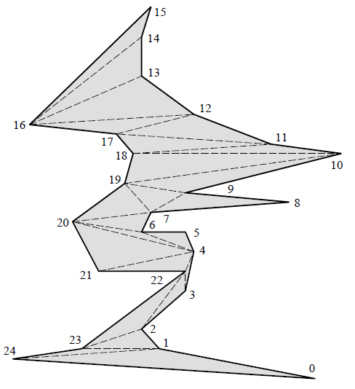
y-Monotone Polygon
y
Monotone polygon may contain many reflex vertices

Slide 18
Monotone Polygons
How do you test monotonicity of a polygon if no direction is given? Does there exist any direction w.r.t. which P is monotone?
Preparata and Supowit: O(n)-time algorithm, Information Processing Letters, 1981
P is monotone in direction l
neither x- nor y-monotone
t
l
Every line perpendicular to l intersects P in a connected set; i.e., the left/right chains from bottom, b, to top, t, are each l-monotone
b

Slide 19
Partitioning a polygon with n vertices into monotone pieces and triangulation
Partitioning:
(i) Method via trapezoidation
(ii) Method via “split” and “merge” vertices
Both require plane-sweep techniques
Both take O(n log n) time

Slide 20
Sweep-Line Paradigm (Horizontal Sweep)
Sort characteristic points of objects by increasing x-coordinates;
Perform plane-sweep along x-axis with a vertical line, halting at vertices in order;
Update sweep-line status (SLS);
Take appropriate actions depending on applications
sweep-line
5
9
10
8
1
2
3
7
6
4
11
x
Ref: David Mount’s Lecture Notes; 4A Textbook

Slide 21
CS60064 Spring 2022 Computational Geometry
Instructors
Bhargab B. Bhattacharya (BBB)
Partha Bhowmick (PB)
Lecture 08 & Lecture 09
21 January 2022
Indian Institute of Technology Kharagpur
Computer Science and Engineering
Notes:
Good Morning!
The title of today’s talk is “On some Planar Partitioning Problems”.

Slide 22
Partitioning a polygon with n vertices into monotone pieces
Method via trapezoidation

Slide 23
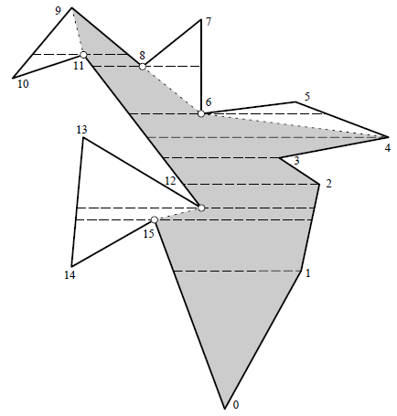

Partitioning a polygon into y-monotone pieces
y-monotone

Slide 24
Partitioning a polygon into y-monotone pieces
Trapezoidal space partitioning
Process vertices in sorted order from top-to-bottom;
Draw horizontal lines through each reflex vertex of P, and through those convex vertices whose both neighbors lie in opposite sides of the horizontal; this divides the interior of P into trapezoidal “slabs”;
Identify each trapezoid t whose support vertex v is reflex and lies somewhere in the middle of the corresponding horizontal side;
Join v with the other support vertex k of the same trapezoid t.
Not
y-monotone
How will the left wall (13, 14) and right wall (1,2) of a trapezoid be identified?
y-monotone
Partitioned into five
y-monotone pieces

Slide 25
Implementation: Plane-Sweep Technique
Sort the vertices from top-to-bottom
(Assume for simplicity, all y-coordinates are distinct)
Sweep a horizontal line downward starting from the top-most vertex; stop at discrete points, i.e. at vertices
Two key ingredients of any sweep algorithm:
(i) Maintain “Sweep Line Status” (SLS): a “combinatorial description” of the “slice” seen by the sweeping line
Often stored in a balanced binary tree
(ii) Event Queue: Actions to be taken, sometimes prioritized, using appropriate data structures

Slide 26
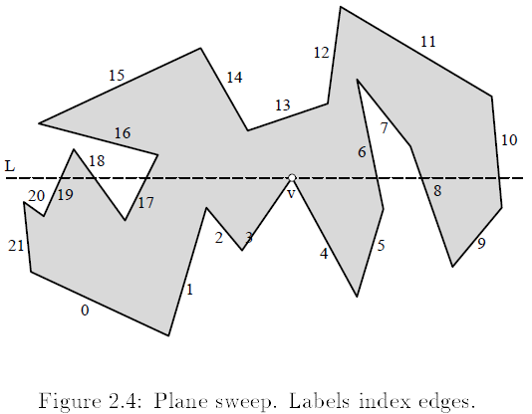
Example: Partitioning a polygon into y-monotone pieces via trapezoid processing
Sweep-line status (SLS) for the current v:
Ordered edge-list: (e19, e18, e17, e6, e8, e10)
J. O'Rourke: Computational Geometry in C, Cambridge Univ. Press, 1998

Slide 27
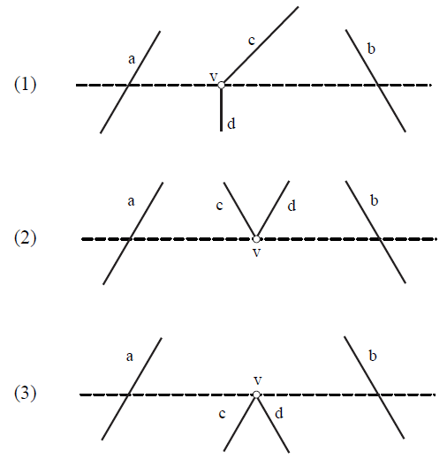
Actions Needed
Delete c from the list, insert d in place of c:
…, a, c, b… → …, a, d, b, ….
Delete c, d from the list
…, a, c, d, b… → …, a, b, ….
Insert c, d in appropriate positions of the list
…, a, b… → …, a, c, d, b, ….
We do O(1) updates to the SLS, each taking time O(log n), since the SLS is stored in a balanced binary search tree

Slide 28
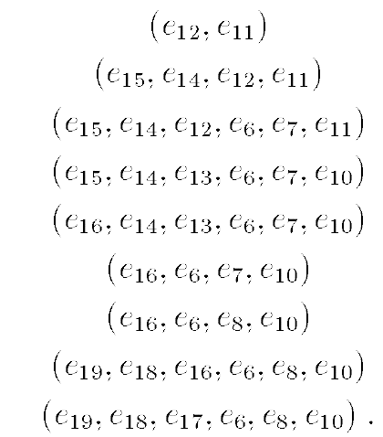

Processing: SLS keeps track of edge-lists in an height-balanced binary tree
Insertion, deletion of edges, and identifying left and right walls of a trapezoid can be accomplished in O(log n) time, per vertex

Slide 29
Complexity of monotone partitioning
Sorting of y-coordinates of n vertices: O(n log n)
Horizontal sweep-line stops at n points
At each vertex, update and trapezoid formation:
O(log n) using AVL-tree of O(n)-size edge lists
Finding support vertices of each trapezoid: O(1)
Total number of trapezoids: O(n)
Total partitioning cost into monotone pieces:
O(n log n)

Slide 30
Monotone Partitioning via “Spilt and Merge” Vertices

Slide 31
top-vertex (start-vertex)
y
top vertex v_{t}: a strictly convex vertex such that both its two neighbors lie below the horizontal line through v_{t}
bottom (end)-vertex
bottom vertex v_{b}: a strictly convex vertex such that
both its two neighbors lie above the horizontal line through v_{b}

Slide 32
Vertex classification in a polygon w.r.t. y-axis
Status of each vertex can be determined in O(1) time
y
convex, both neighbors
convex, both neighbors
one neighbor , other
reflex, both neighbors
reflex, both neighbors
Lemma: A simple polygon P is y-monotone if and only if P is devoid of any merge or split vertices
⇒ P will have only one start- and one end-vertex
Ref: 4A Textbook

Slide 33
P is devoid of any merge or split vertices;
P has only one start- and one end-vertex
P is y-monotone
y
P

Slide 35
merge vertex
sweep-line
sweep-line
split vertex
Handling “split” is fine as its possible matching vertices are already explored by the sweep-line. How about “merge”?
Management of “merge” needs a reverse sweep at the end

Slide 36
Handling Split Vertices
Lowest vertex above the sweep-line touching v_{i} and lying between e_{j} and e_{k}
y
Insert diagonal between v_{i} and
helper(e_{j})
Sweep-line touches split-vertex v_{i}
sweep-line
Otherwise, connect v_{i} with the upper end-point of e_{j} to create a diagonal
split vertex: reflex,
both neighbors
Ref: 4A Textbook

Slide 37
Handling Merge Vertices
How do you identify v_{m}?
y
v_{i} would become helper(e_{j}) when sweep-line reaches v_{m} later
Insert diagonal between v_{i} and v_{m}
sweep-line
Sweep-line touches split-vertex v_{i}
Highest vertex below the sweep-line touching v_{i} and lying between e_{j} and e_{k}
Otherwise, connect v_{i} with the lower end-point of e_{j} to create a diagonal
merge vertex: reflex,
both neighbors
Ref: 4A Textbook

Slide 38
helper

Slide 42
Sweep-Line Algorithm
Events: Vertices of polygon, sorted in increasing order by
y-coordinates (no new events will be dynamically added)
Sweep-line status: Balanced binary search tree storing the list of edges intersecting sweep line, sorted by x-coordinates; Also, helper(e) for every edge intersecting the sweep line
Event processing of vertex v:
start vertices
end vertices
regular vertices
merge vertices
split vertices

Slide 43
left
left incident

Slide 44
v
Determine for vertex v the
edge left(v) directly left to v

Slide 46
Sweep Line Algorithm
Insert diagonals for merge vertices with “reverse” sweep
Each update takes O(log n) time
There are n events
→ Run-time to compute a monotone subdivision is O(n log n)

Slide 47
Algorithm: Monotone Partitioning
A data structure for storing planar maps. Allows insertion of a diagonal in O(1)time
Theorem: A simple polygon with n vertices can be partitioned into y-monotone polygons in O(nlogn) time with an algorithm that uses O(n) storage
Ref: 4A Textbook

Slide 48
Example
Partitioned into six monotone pieces: Can you reduce the number?

Slide 49
Triangulate an l-Monotone Polygon
Sort vertices by increasing l-coordinates (merging the upper and lower chains in O(n) time)
Perform plane-sweep in direction l, halting at vertices in order
Triangulate everything by adding valid diagonals to the left of the sweep line; maintain a stack and use orientation tests
sweep-line
7
11
12
2
10
3
4
5
9
1
8
6a
6
13
l
Ref: David Mount’s Lecture Notes; 4A Textbook

Slide 50
Triangulate an l-Monotone Polygon
Store in a stack (sweep line status) the vertices that have been encountered but may need more diagonals
Un-triangulated region has a funnel shape; The funnel comprises a line segment (one side) and a reflex chain (interior angles >180°) on the other side, which is pushed into the stack
Update: Case 1: new vertex lies on chain opposite of reflex chain; triangulate;
pop-off occluded vertices

Slide 51
Triangulate an l-Monotone Polygon
Update, Case 2: new vertex lies on reflex chain
Case a: The new vertex lies above line through previous two vertices; triangulate
as far as possible (via orientation tests);
pop-off occluded vertices
Case b: The new vertex lies below line through previous two vertices; add to the reflex chain (stack)

Slide 52
Ref: David Mount’s Lecture Notes; 4A Textbook

Slide 53
Triangulate an l-Monotone Polygon
Distinguish cases in constant time using chain information and orientation tests
Sweep line hits every vertex once, therefore each vertex is pushed on the stack at most once
Every vertex can be popped from the stack (in order to add a diagonal) at most once
Constant time per vertex
O(n) total run-time
Please convince yourself how monotonicity helps!

